Slide 1
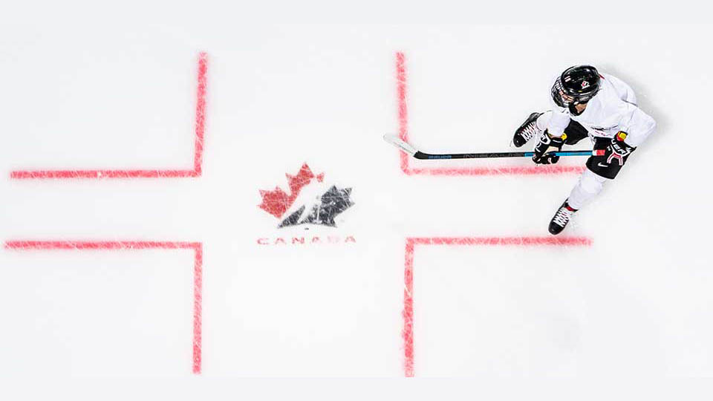
Coaches and Managers Meeting 2022-23

Slide 2
Welcome and Introductions
Thank You for being here today!!
Without your efforts as a volunteer in our association, over 400 kids would not be able to play this wonderful game of hockey.

Slide 3
Update from Mark Reinert
Petawawa Parks & Recreation Facilities Supervisor
Please ensure no bench staff, players or parents are walking past the Zamboni doors to get to the bench.

Slide 4
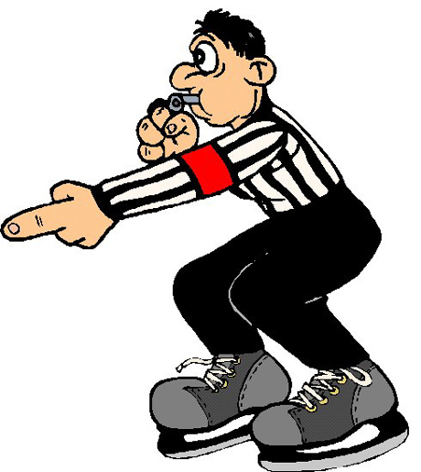
Referee In Chief Chris Misztal
Convenors/Rep Managers notify Ice Allocator of game changes, Allocator tracks and passes on to Assignor.
If you've asked for Refs, no news is good news
Happy to answer questions to clarify penalty codes/potential suspension lengths but ultimate authority is League and D5 RIC
You're not entitled to explanations

Slide 5
Maltreatment is focus again, all appeals (Minor and Junior) denied at HEO Discipline Board last year
Green armband is here to stay, only 3 suspensions in all of HEO last year = Success
Complaints in Petawawa? Wait 24 Hours, email me at gpraric@hotmail.com
Complaints from Away Game? Wait 24 Hours, email Davis Scheel at district5ric@hotmail.com and CC me for tracking purposes.
Timekeepers need to know what they're doing
Game won't continue until clock is correct this year

Slide 6
Things to Remember
Games that require to be rescheduled should be rescheduled in the same month.
Give as much lead time as possible to opposing team manager about rescheduling. Only exception is inclement weather.
All House is three 10 min. stop time periods. U9 is 2x23min periods
Competitive – U11, three 12 min. stop time periods.
Competitive - U13, U15, U18, three 15 min. stop time periods
UOVMHL – House Teams No East/West split this year.
Team Pictures – Will be scheduled shortly, stay tuned to announcement through your convenors for timings for your teams.
Noisemaking devices have been banned in all UOVMHL sanction events. Please respect the signage and your fellow visitors.

Slide 7
Ice Allocator
Julia Misztal
Ice will only be allocated via website, no spreadsheet. Only exception is under 48 hour notice changes or bonus ice emailed to Rep Managers/Convenors
Only U18 Rep have fixed practices, impossible for everyone else with 27 teams
Times start 5PM on weekdays, 7AM on Sat/Sun, late ice (8PM+) saved for older ages
Can’t make a practice? Switch with a team in your division (U15 T1 to T2) or return ice to your convenor
Tournament dates should be given to the ice allocator ASAP to limit rescheduling.
Ice is balanced over the whole season, new website tracks distribution for me.
Ice for the association can ONLY be booked by the ice allocator.

Slide 8
Complaints HL Director : Tara Weichenthal
Use the 24 hour rule (cooling off period).
Need to follow the chain of command.
Need to be formally stated.
Will not entertain complaints if they do not follow the chain and are not documented and signed.
Members that fail to follow this process and the proper Chain of Command, may result in parent/player suspensions as determined by the GPMHAI Executive.
NOTE - Don't use email to express your opinions or displeasure. Emails are shared too easily with everyone that do not need to know your buisness. Emails are terrible for depicting your tone and mood. Rather pick up the phone and state your case.

Slide 9
Chain of Command
Parent ⇨ Manager
Manager ⇨ Coach
Coach ⇨ Convener
Convener ⇨ Director
Director ⇨ President or Designate

Slide 10
Privacy
The GPMHAI respects everyone’s right to privacy and confidentiality.
The GPMHAI collects personal information from prospective members, members, coaches, referees, managers and volunteers for the purposes of conducting Hockey Programming.
Information specific to a player such as a player's name, address and date of birth are collected to determine that the player's geographical, division of play and level of play information are consistent with Hockey Canada/Branch regulations. Historical information concerning past teams played for is collected in order to determine if any GPMHAI transfer regulations may apply.
At no time are lists generated by the GPMHAI for the purpose of marketing, or the sale of information.
Team Officials must comply with the GPMHAI Privacy Policy. Team lists and phone numbers are not to be shared with anyone outside of GPMHAI and specifically may not be distributed to outside agencies, companies, associations or individuals.
Use of photos on this site are provided by coaches/managers and GPMHAI Executive. If you do not wish to have your child's photo displayed on the GPMHAI web site and related marketing, please contact your GPMHAI Division Convenor.
If you have any questions or concerns regarding the GPMHAI Privacy Policy or the use and distribution of personal information, please contact the Secretary of the GPMHAI.

Slide 11
Hockey Jerseys & Socks Jamie Mason
The cost of jerseys, shells, and socks for the Rep teams are as follows, please keep in mind that the supplier has given us the prices from the 18/19 season.
Shells $34.00
Jerseys $44.00 each Goalie jerseys $48.00 each.
Socks $16.99 each set
Approximate break down for each player
$34.00 + ($44.00 x 2 = $88.00) + ($16.99 x 2 = $33.98) = total of $155.98 per Player
$34.00 + ($48.00 x 2 = $96.00) + ($16.99 x 2 = $33.98) = total of $163.98 Per Goalie
The association is paying the upfront cost, the team will be responsible to collect from the families and turn into Sarah (Treasurer) or Jamie (Equipment Manager), players will not be allowed on the ice if it is not paid.

Slide 12
Hockey Jerseys & Socks
A’s and C’s on jerseys have been removed. I am working on getting Velcro patches and Velcro letters.
Team Jerseys not to be worn at practice.
Jerseys not to be stored in hockey bags. (U7 Timbit and U11-AtoMc are Exempt)
Absolutely no name bars on jerseys.
Socks are not to be worn for practice.
All U9, U13, U15 and U18 teams are required to wear GPMHAI jerseys and socks for all exhibition, league, and tournament games.
The U11 teams will utilize the McDonalds® AtoMc jerseys for all practices and game play. One set of GPMHAI jerseys will be provided to the U11 teams, if needed, in case of conflict with another AtoMc team color.
U7 teams must wear the provided Tim Horton’s jerseys and matching socks for all practices and exhibition/fun days.

Slide 13
Please note that GPMHAI is a registered trade mark and at no times is it acceptable to reproduce clothing independently or apply the trademark without express consent from the Association*
Each Petawawa team will represent our association in a consistent and appropriate manner, eliminating excessive ordering and inflated pricing by using one supplier and ordering in bulk.
All teams will be offered the same clothing line with "Patriots" word mark on back of warm up jackets. All other pieces will be identical.
Please note, that no additional wordmark or team logo is to be added to any Petawawa apparel without written consent from the G.P.M.H.A. Executive. Likewise, our logo(s) are the property of the G.P.M.H.A and is not be added to clothing, hockey bags, tuques etc unless approved by the Executive and can only be embroidered by our approved vendor.
No additional accreditation/awards or team names will be added to any apparel unless approved by the G.P.M.H.A. Executive.

Slide 14
Game Sheets
Important to have game number, date, location correctly entered on the game sheet.
Also requires listing of the District, Division that is playing and the League. Our District is #5, League is UOVMHL, Division example is Novice.
Important that score keeper places in their contact information on the area provided on the game sheets.
123
Novice
2012 Oct 11
Petawawa
UOVMHL
5
John Doe
613-555-1234

Slide 15
Game Sheets Continued
Coach or Assistant Coach (someone in control of the team while on the ice) must sign to verify the filled out game sheet. Don’t forget to include your suspended players.
Stickers are allowed to be used. Ensure all four sheets have a sticker on them.
Ensure changes are made on all four stickers. (I.e. crossing off missing players.)
Trainers - ensure trainer numbers are included on the game sheet.
Coach Crab
1
5
000121
Naughty Player
1
1
000122
Asst. Coach Glad

Slide 16
Game Sheets Continued
Home Games sheets are distributed as follows:
Top copy (official) stays with home team, for Uploading. (7 Days)
2nd and 3rd copies go to coaches/managers of the teams playing, for their records.
All game sheets exhibition/tournament and league are to submitted to the league convenors, if there are any issues/suspensions.
It is the home teams responsibility to upload the games sheets in a timely fashion in order reconcile the league points.
If you have suspensions best to notify league convenor ASAP and send a soft copy via email for determination of # games to be served.

Slide 17
Time Keeping And Penalty Box
No children in time keeper box under the age of 16! (Unless they have taken the timekeepers course)
Two people in the time keeper box, one on the clock, the other on game sheet.
Get your parents to step up and volunteer for this duty and spread it around the team.
How-to files are available on our website. Managers can request/run training session, get in touch with your convenor.

Slide 18
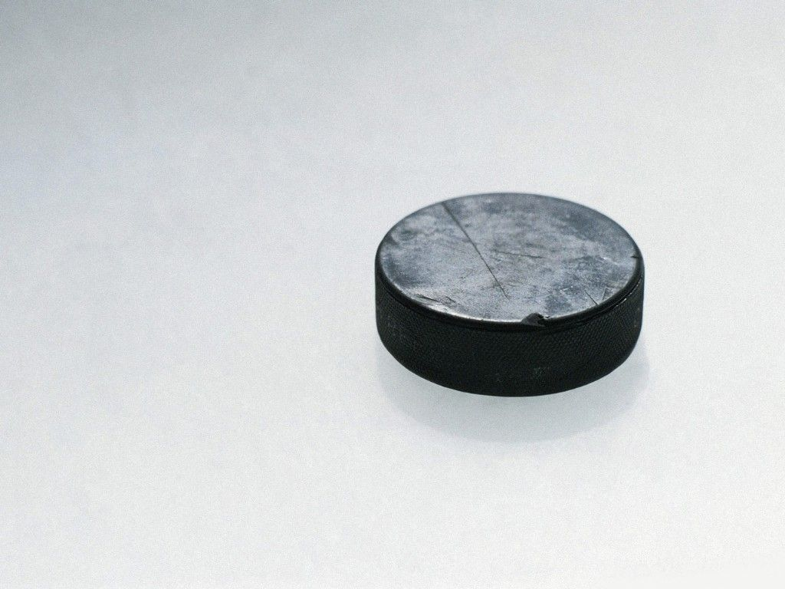
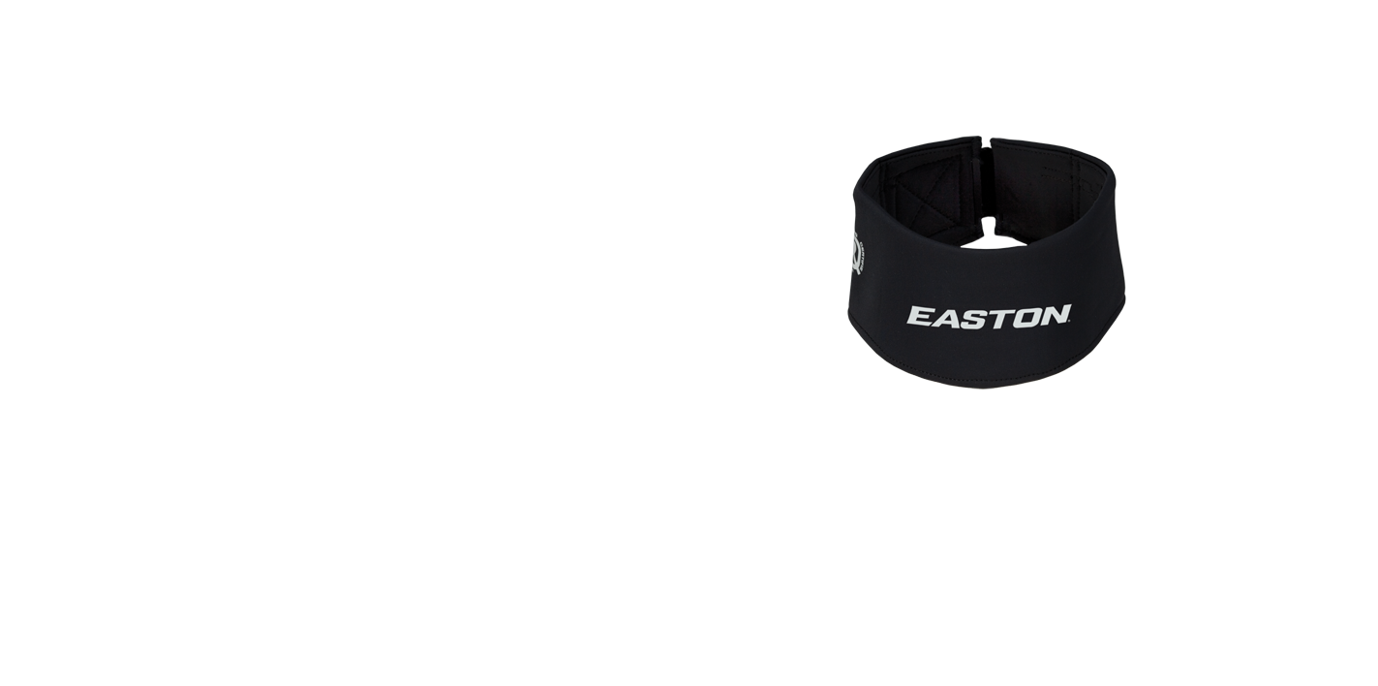
Risk And Safety

Slide 19
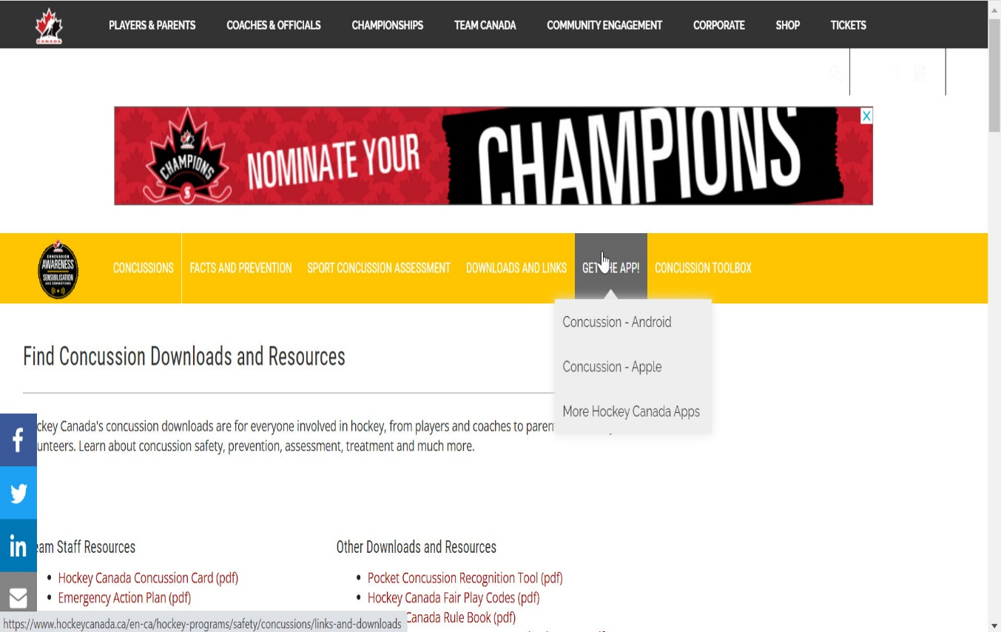
Concussions
HEO Concussion Protocol
http://www.hockeyeasternontario.ca/docs/HEO_6_Step_Concussion_Return_to_Play_Protocol.pdf
Hockey Canada Concussion Page
https://www.hockeycanada.ca/en-ca/hockey-programs/safety/concussions/links-and-downloads

Slide 20
Other than concussion injuries
HEO linked Injury Report
http://www.hockeyeasternontario.ca/docs/HC_Injury_Report_Eng.pdf
What is a significant injury?http://www.hockeyeasternontario.ca/docs/6.30%20Significant%20Injury%20Return%20to%20Play%20Policy.pdf
Frequently asked questions: (FAQs) http://www.hockeyeasternontario.ca/docs/HC_Injury_Report_FAQ.pdf

Slide 21
Vulnerable Sector Screening
All Team Bench Staff and Volunteers MUST have an up to date (within the last 3 years) Vulnerable Sector Screening recorded to continue to participate in hockey activities.
The VSS letter for Town residents and the OPP web-link are posted on our website under Risk And Safety. Print the letter, fill it out and apply on-line via the OPP website.
For residents that reside on the Canadian Forces Base, the letter is there as well, attend the Military Police Station on Somme Rd., CFB Petawawa in person to apply.

Slide 22
Dressing Room
Coaches you are responsible for your players from the time you enter the rink until they leave.
Two Deep Rule – In dressing room at all times in all levels. Many instances of bullying at the U15 and U18 age Levels in HEO. Need to ensure we provide our kids a safe environment.

Slide 23
Cameras
No cameras allowed in dressing room period!!
This includes parents, kids, and coaching staff.
Coaches and Managers ensure this policy is strictly enforced. You will be included in hearings if violations of the policy are brought to light.
The use of any form of camera, video camera, or phone camera for taking still photos, video or audio recordings is prohibited in any recreational facility change rooms, during any HEO sanctioned event.

Slide 24
Protective Equipment
Neck Guards are mandatory.
Mouth guards are strongly encouraged to be worn. Should be worn correctly to ensure adequate protection.
Helmets require ear protection.
Goalies require the (Billy goat) dangler. Will be enforced by referees.
Any child 12 and over, if helping other teams (on ice helper) during practice, must be registered in our association and in full gear. Must also be at least one division higher than the team they are helping. They are strictly to be used as demonstrators of the drills and help move pylons and pucks. Not to be scrimmaging with the team and or shooting on the on the goalies.
The association requires that an on ice helper approval form (Coaches Corner Link on Website) be read, filled and signed prior to the one ice helper taking the ice.

Slide 25
Website/Social Media Chris Misztal
New website this year = Easier to manage
Sportsheadz App is optional but TeamSnap won't autoupdate unless you pay
GPMHA Website – Each team has their own area where schedules and announcements, photos, etc can be placed. Team managers will have logins
If you don't have your login yet, please let your house league director know and they can compile a list
Keep complaints off Facebook, use the proper Chain of Command. Otherwise please share, discuss and comment on posts!

Slide 26
Qualifications Karen Mason
All bench staff must have (1) Respect in Sport – Activity Leader, (2) Gender Identity and Expression course and a valid vulnerable sector check with GPMHAI before they can be placed on a roster;
A certified trainer must attend each house league practice, game and U7 on-ice session played by an HEO Minor team, ensure trainer # is written on the game sheet;
Trainers for house league teams & U7 sessions must have their HTCP Trainer Level I certification prior to serving as Trainer at any game/practice/session/event;
Trainers for competitive teams must have their HTCP Trainer Level II certification prior to serving as Trainer at any game/practice/event;
Coaches – Need someone with same qualifications as you to run the team in your absence. i.e. a back-up with coach stream for house and Dev 1 for competitive; and
All on ice Coaches/Assistant Coaches/Instructors in the U7 Program must take the Coach 1 course. There are no exceptions to this rule and no other levels of qualification are acceptable at the U7 level

Slide 27
Qualifications
Head Coaches shall choose their bench staff based on the qualified persons on their teams. Where there are no qualified assistants or trainers the GPMHAI will reimburse volunteers for the cost of the certification course.
Volunteers will be reimbursed the cost of the course at the end of the season. The GPMHAI will not reimburse the certification of a trainer or assistant when a qualified and willing person was not selected. To ensure reimbursement, verify eligibility with the GPMHAI House League Director and appropriate Convenor prior to taking any courses

Slide 28
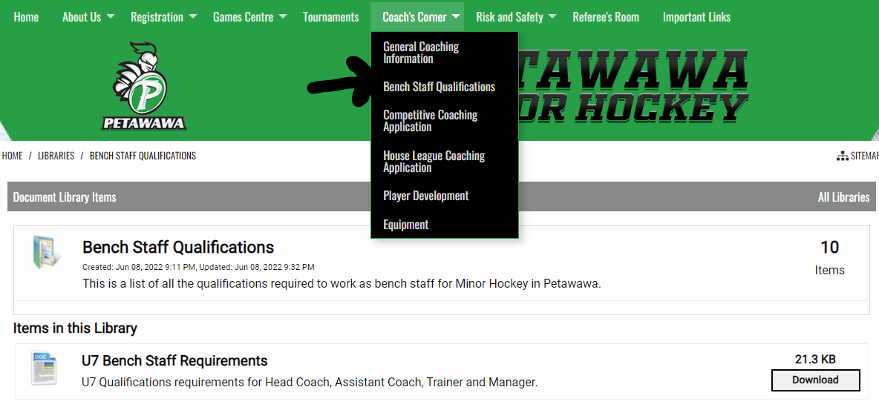
Qualifications
The required qualifications for trainers and coaches for the specific levels and divisions can be found on GPMHAI website (click on the Coach’s Corner link)

Slide 29
Forms
Affiliation Form – Required for playing with higher category team.
Special Event Form – Is now electronic and required to ensure insurance coverage while not at rink.
For off ice training, mini-golf, paint ball...etc.
Travel Permit Form – Required when playing games outside of our Branch, again for insurance purposes.
Example if playing in Kingston, North Bay, Mattawa, Shawville
Fair Play Code Pledges – Players, coaches and parents will be required to read, complete and sign, they are kept with the Team Managers.
Coaches/Parents – please maintain your composure while at any HEO Minor sanctioned event. We continue to see young referees in the district between the ages of 13-17 quit due to aggressive behaviors of individuals. Please remember whether you believe it or not you are representing our Association, please act accordingly. The Associations within our District have recently adopted a policy that if a parent is banned from one rink within the District, they can also ban the same individual from their rink as well, If so desired.

Slide 30
Team Lists
Need a qualified coach and trainer to make an approved roster.
You cannot play in a tournament or league game until you have an approved roster.
Managers always keep a copy of your roster with you for hockey business.
If a house coach is missing one of the coaching certifications for the level they are coaching and they are registered for an upcoming course, they will be listed as pending, they can participate, and the roster is approved
First five staff on team list are covered by GPMHAI insurance. Further team staff can be added at a cost of $50 per individual.
No individual shall be on GPMHAI sanctioned ice if they are not on a team list in the association. (Exception for GPMHAI executive members) This includes all members installing U9 center boards
One goalie must be designated for U15 age and higher on a team list. Once designated as a goalie this individual cannot play out as a player. The same applies for U13 age and below, if you designate a goalie on your team list (not required) the individual cannot play out.

Slide 31
Affiliations
Affiliations for house will not take place until Rev. 0 of team list approved by District Registrar;
Affiliated players do not step on ice with the affiliating team until the approved team list comes back from District Registrar;
Use the affiliation forms available on our website (Coach’s Corner);
Affiliated players alliance stays with the lower team;
A coach cannot deny a player the opportunity to affiliate;
Affiliates can be used in games if the following criteria are; met. The higher team has a player that is sick, injured, away or suspended.

Slide 32
Affiliations Continued
The AP forms are available on our website (Coach’s Corner). U18 AP’s can only play a total of 10 games in the entire season with their affiliate team;
Affiliate Rules: 7.4.2 Coaches wishing to use an affiliate in a game or tournament must receive permission from the players’ regular coach first. Failure to do so will result in discipline;
U18 - It is the responsibility of the player/coach and parent to keep track of the number of meaningful games played;
Tournament and exhibition games are not included in the 10-game rule;

Slide 33
Affiliations Continued
Good communications are required when using affiliated players. The lower coach must be approached for a request to use the affiliated player in practices or in games. Higher coaches, do no ask the parent, or worse yet, the player if they are available to play with you. Talk with the coach;
Follow affiliation regulations outlined Section 8 of the HEO Minor Rules/Regulations, Appendix B and the GPMHA constitution; and
Suspensions are served with the lower category team, regardless of which team the player incurred the suspension with.

Slide 34
Convenors

Slide 35
Convenors
Coaches and managers get to know your respective League convenors.
These are the people that need to be contacted immediately (24 hours) about suspensions of players or coaching staff.
They are the definitive resource that will get you the answers to your questions on ruling for suspensions.
These individuals will be in direct contact with the District Chair and/or League President on these matters.
If you don’t get word from a convener on a suspension and you are in doubt whether someone is suspended for a game, err on the side of caution and do not allow the player to play. If you play an illegible player the coach will be suspended for 5 games.

Slide 36
GPMHA House Convenors
U7 – Chelsea Laporte
U9 – Natasha Brennan
U11- Leslie McKinnon
U13 – Jamie Clouthier
U15 –Kim Mitchell
U18 – Melanie Cyr

Slide 37
Tournaments
- U7 house teams receive $300 towards fun days
- U9 house Teams receive $500 towards fun days
-U11–U18 House teams receive $900 each from the association for tournaments.
•Rep teams receive $1650.
•These funds are administered by our treasurer

Slide 38
Fundraising
Any requests or ideas for fundraising need to be screened prior, by our fundraising chair. (i.e. bottle drives etc.)
Permission will not be granted for any other reason than to cover the costs of tournament fees. These funds cannot be used to fund such activities as banquets, parties, gifts, meals and clothing and can only be used for tournament entry fees.
Each team will place the control of funds in the hands of either the manager or a designated team treasurer. This person will provide quarterly financial statements to the parents of the team, convenor and the association Treasurer. Failure to submit a Team Financial Statement to the Treasurer will result in suspension of the Head Coach. The team may apply to the parents for money to cover costs or they may fundraise . Please submit on Oct 30, Dec 15, Jan 30 and year end with a $0 balance.

Slide 39
GPMHAI Dates to Remember 2022-2023
Item Date
Rep League Starts U11-U18 October 15th
Submission of House Lists to District Registrar October 16th
House League Starts – (U11 – U18) October 21st
Last day for U7, U9 and newly registered players - RiS Parent October 15th
U9 League Starts October 25th
Halloween – No U7, U9 or U11 scheduled ice
Remembrance Day November 11th – Blackout Day – No scheduled hockey (all levels)
Last date for Team equalization December 1st
PLAYOFFS: TBD

Slide 40
Questions

